Slide 1

JSS ACADEMY OF TECHNICAL EDUCATION, NOIDA DEPARTMENT OF ELECTRICAL ENGINEERING
Designing an EV Charging System for Improved Performance
Group No. 12
Supervisor
(Dr. Sanjiba Kumar Bisoyi) (Associate Professor)
Rishabh Khare (1709120079)
Sarthak Singh (1709120086)
Luv Pathak (1709120055)
Abhinav Kumar Singh (1709120003)

Slide 2
OUTLINE OF PRESENTATION
Objectives
Block Diagram
Buck-Boost Converter
- Simulink Model
- Graphical Results
Cuk Converter
- Simulink Model
- Graphical Results
Sepic Converter
- Simulink Model
- Graphical Results
Battery
- Simulink Model
- Graphical Results
References

Slide 3
OBJECTIVES
Complete the literature review for the proposed topic and identify the charger rating required.
To analyze the performance of different converters and select the most suitable converter.
To design the selected converter for the rating of the battery chosen with reduced THD and ripple content.
To develop safety circuit if required and complete the charging system design.

Slide 4
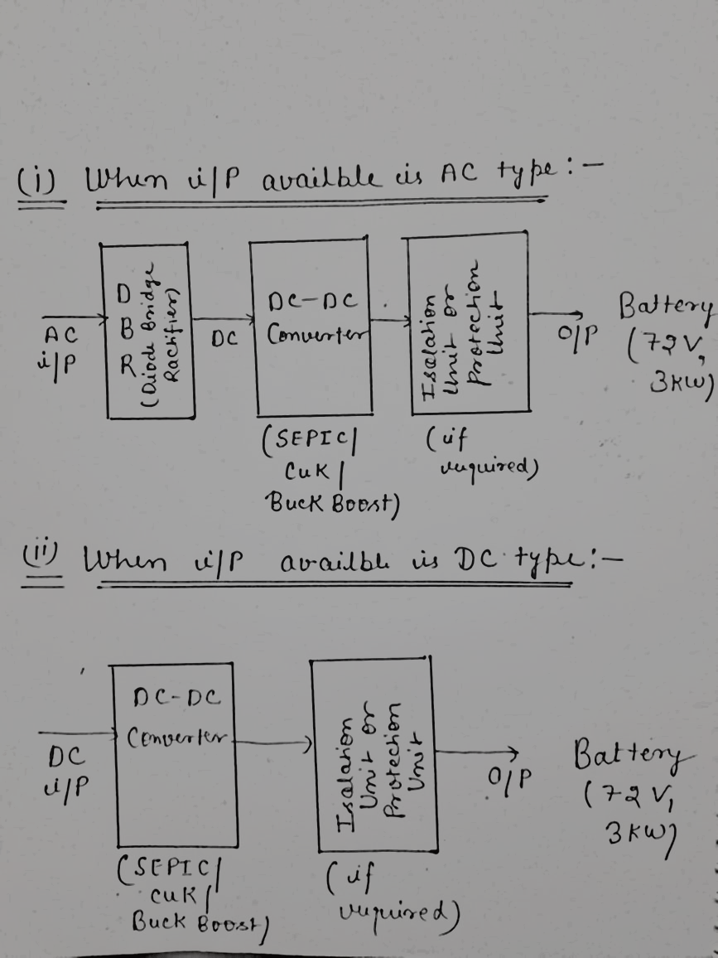
BLOCK DIAGRAM

Slide 5
BUCK-BOOST CONVERTER

Slide 6
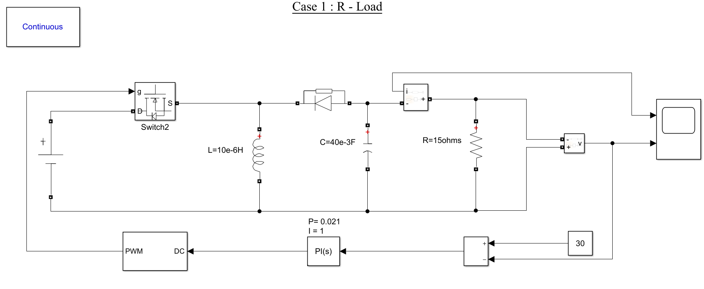
SIMULINK MODEL

Slide 7
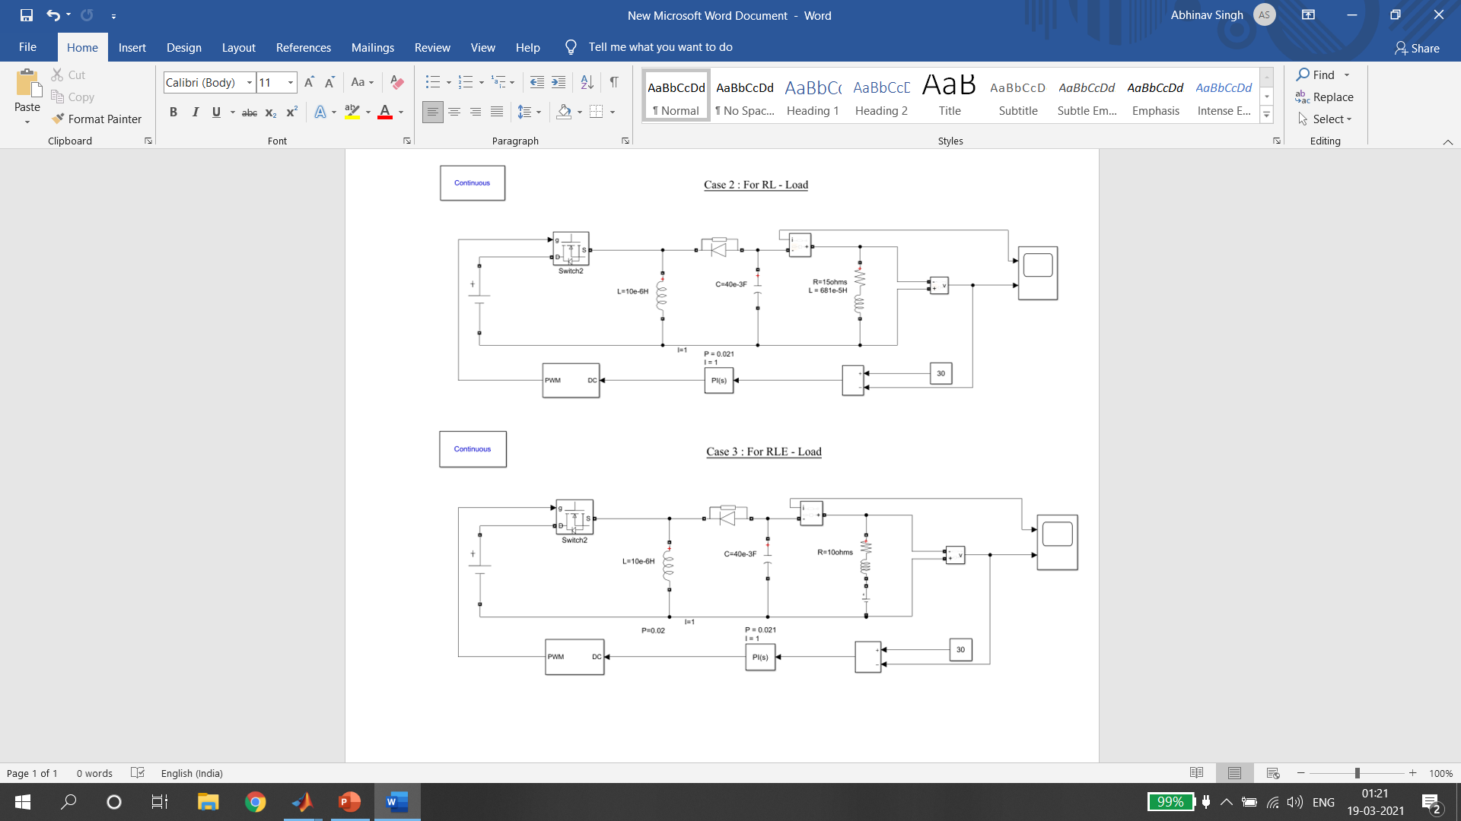

Slide 8
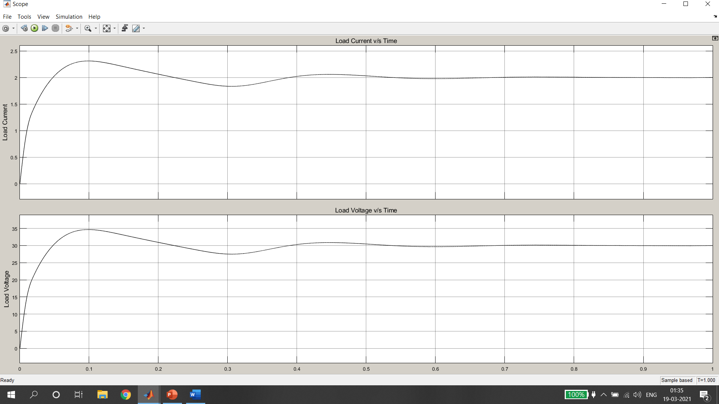
GRAPHICAL RESULTS
Case 1 – For R Load

Slide 9
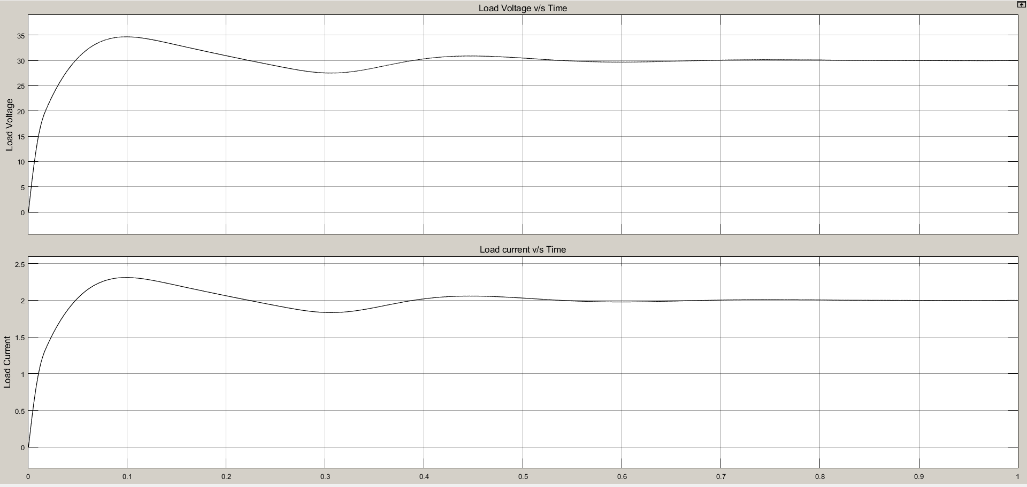
Case 2 – For RL Load

Slide 10
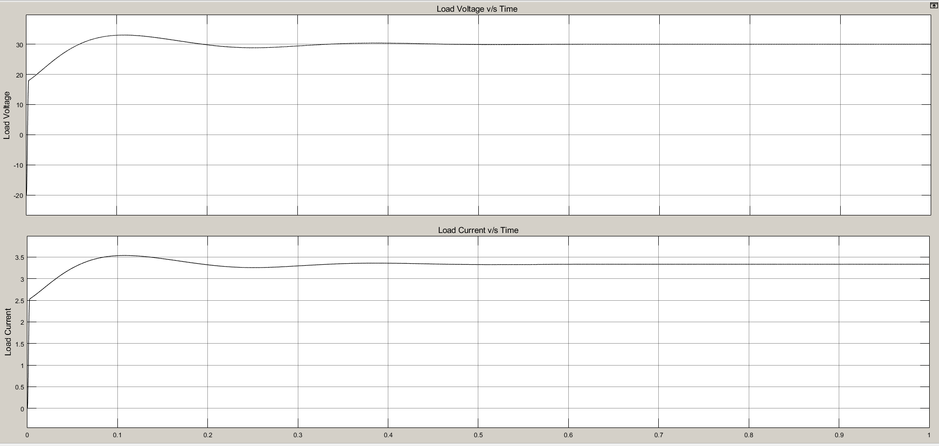
Case 3- For RLE Load

Slide 11
CUK CONVERTER

Slide 12
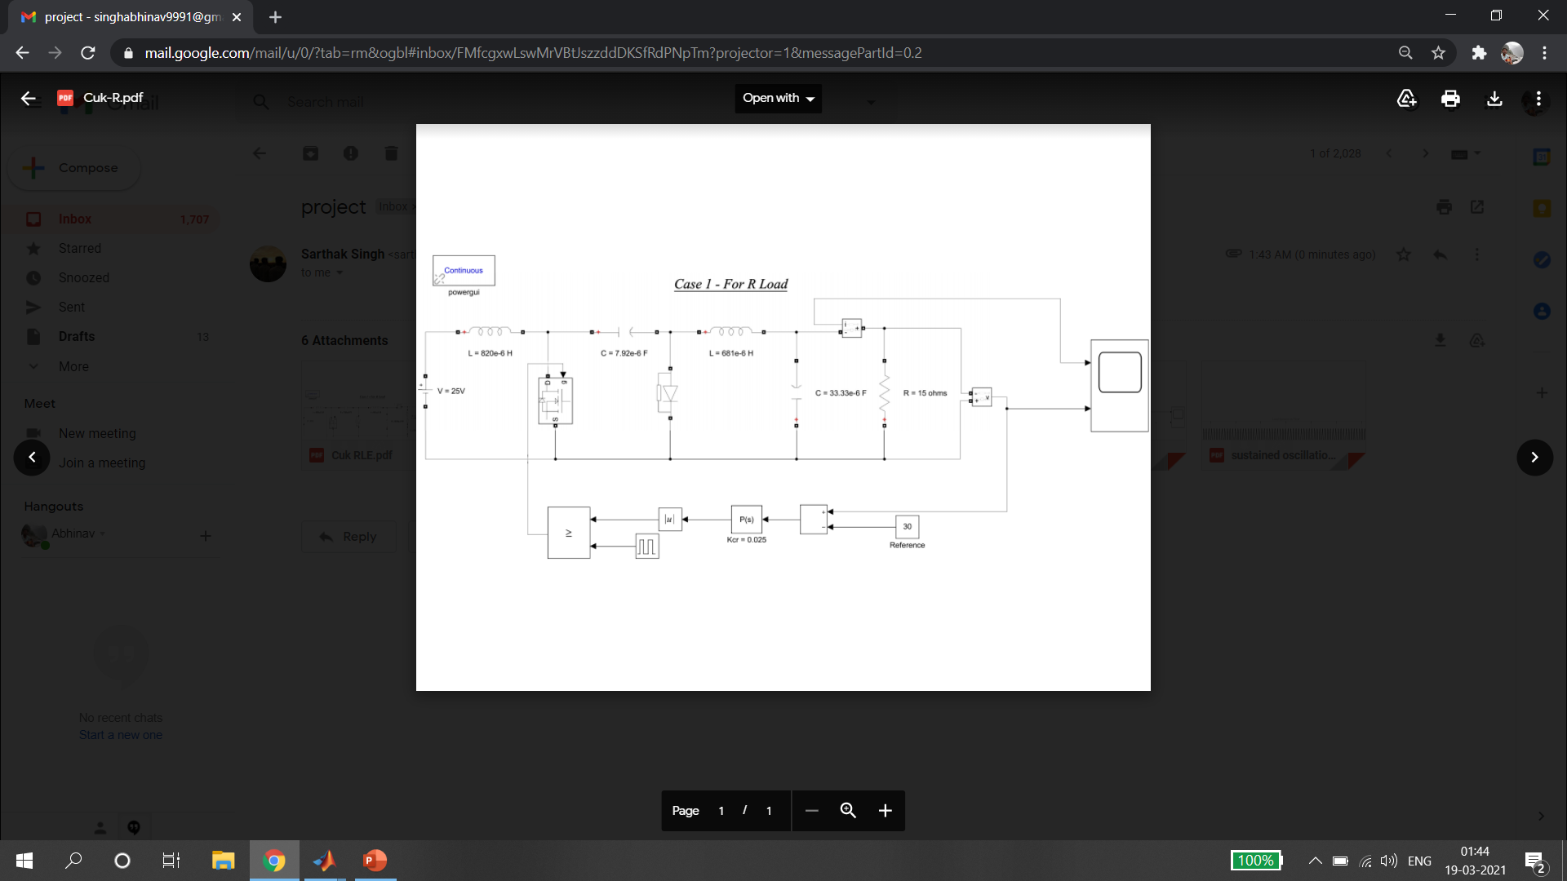
SIMULINK MODEL

Slide 13
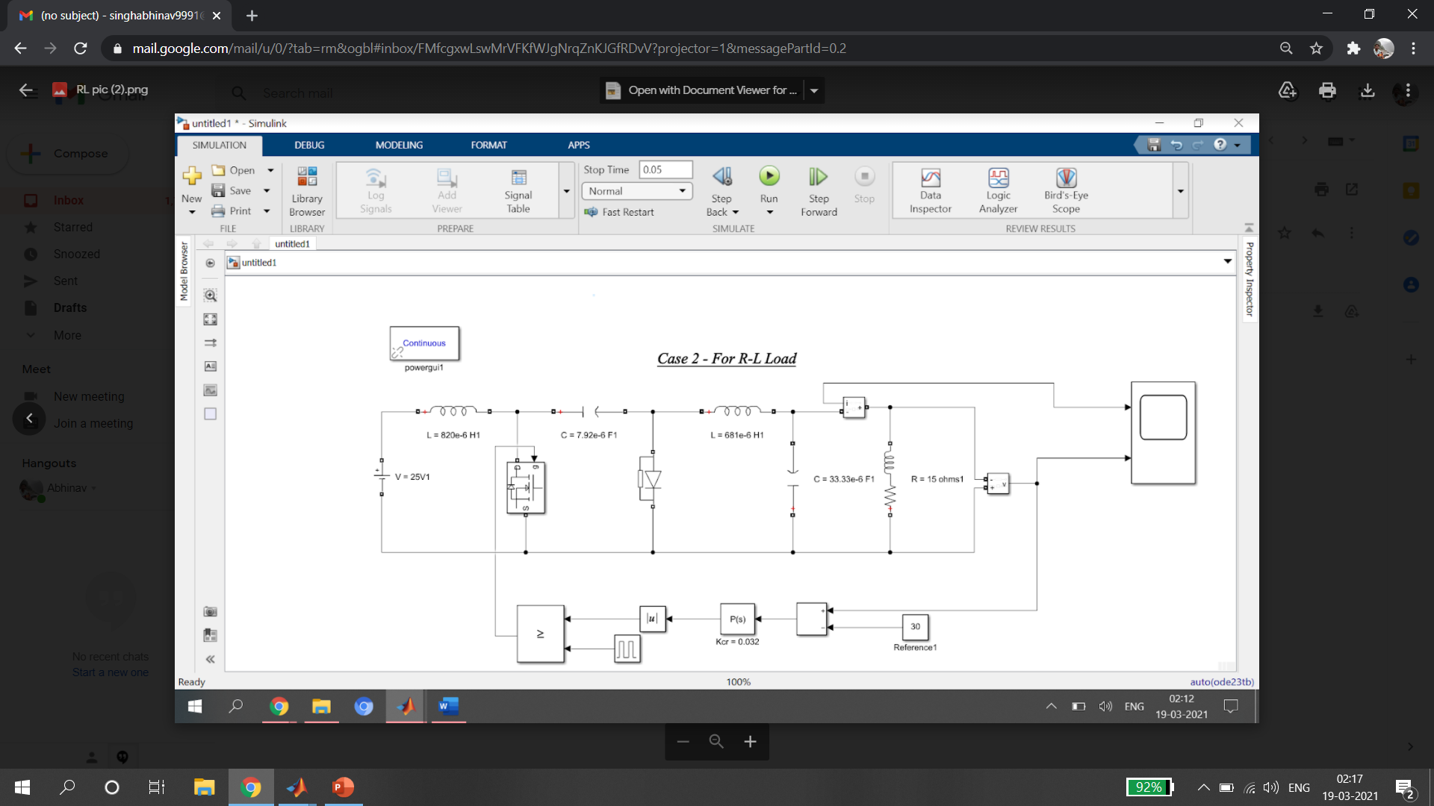
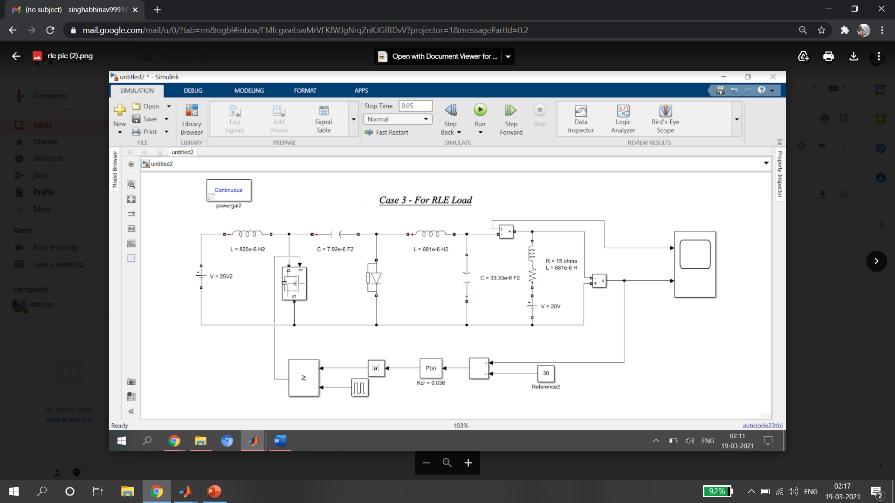

Slide 14
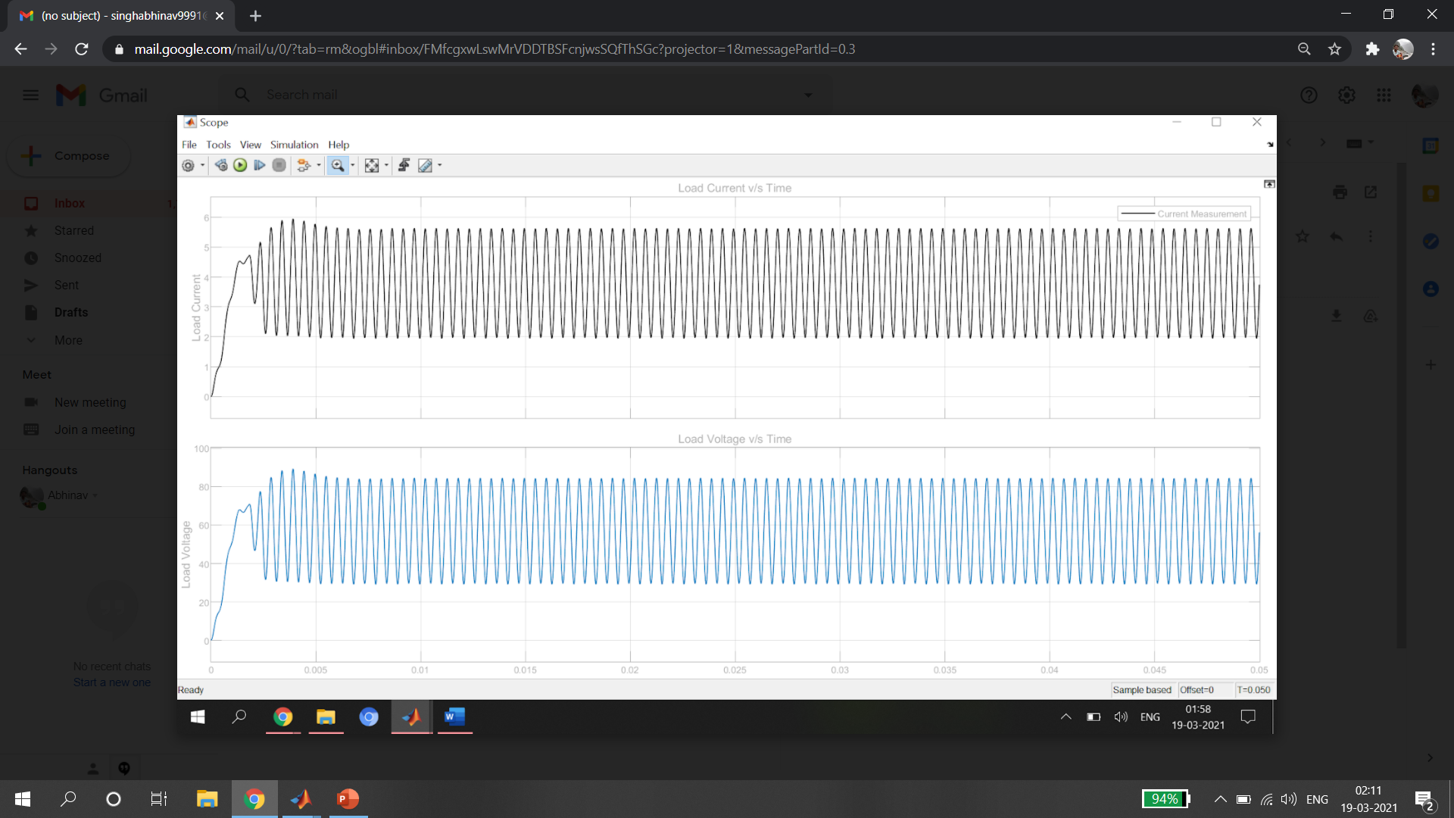
GRAPHICAL RESULTS
Case 1: R Load

Slide 15
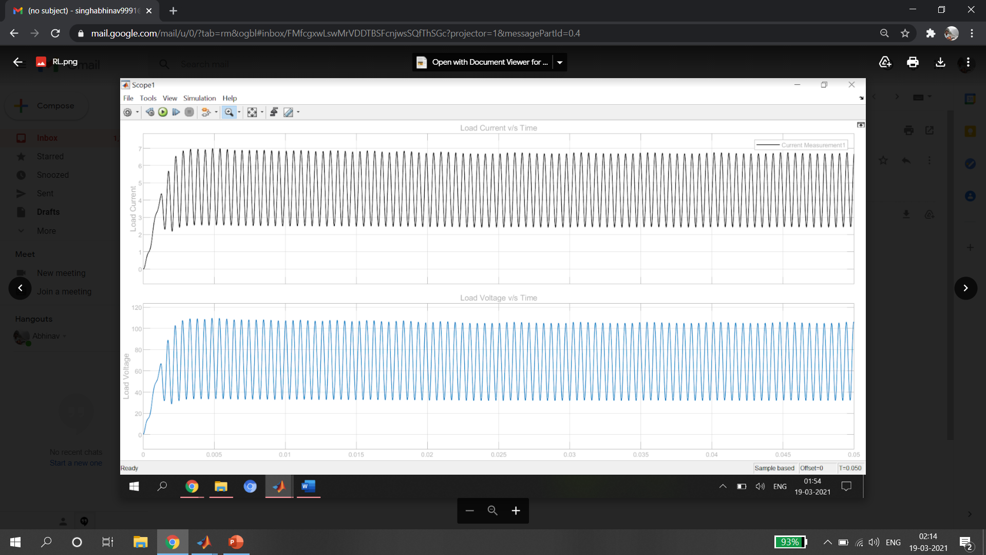
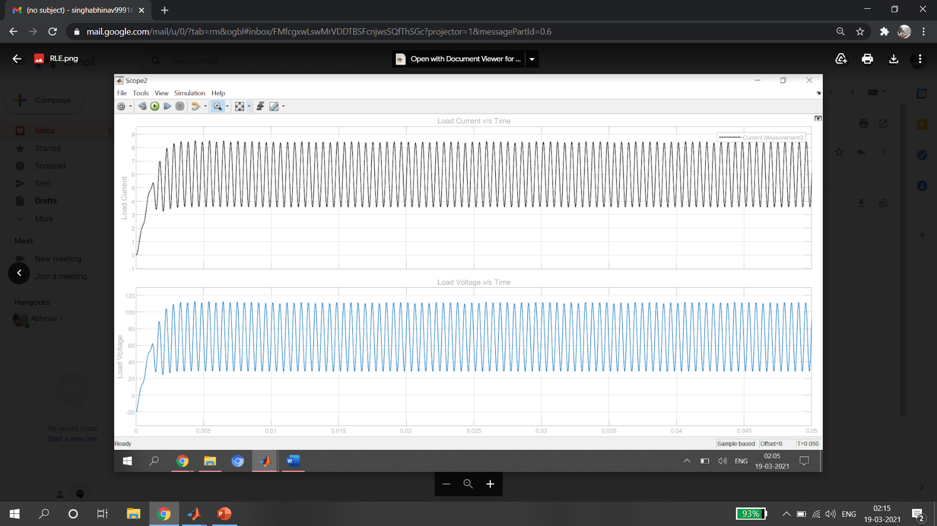
Case 2: RL Load
Case 3: RLE Load

Slide 16
SEPIC CONVERTER

Slide 17
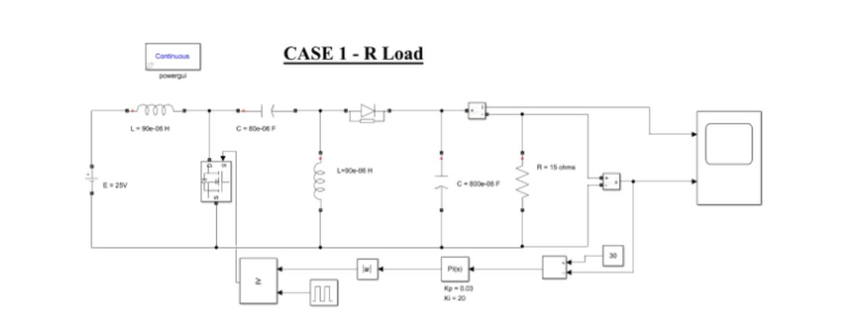
SIMULINK MODEL

Slide 18
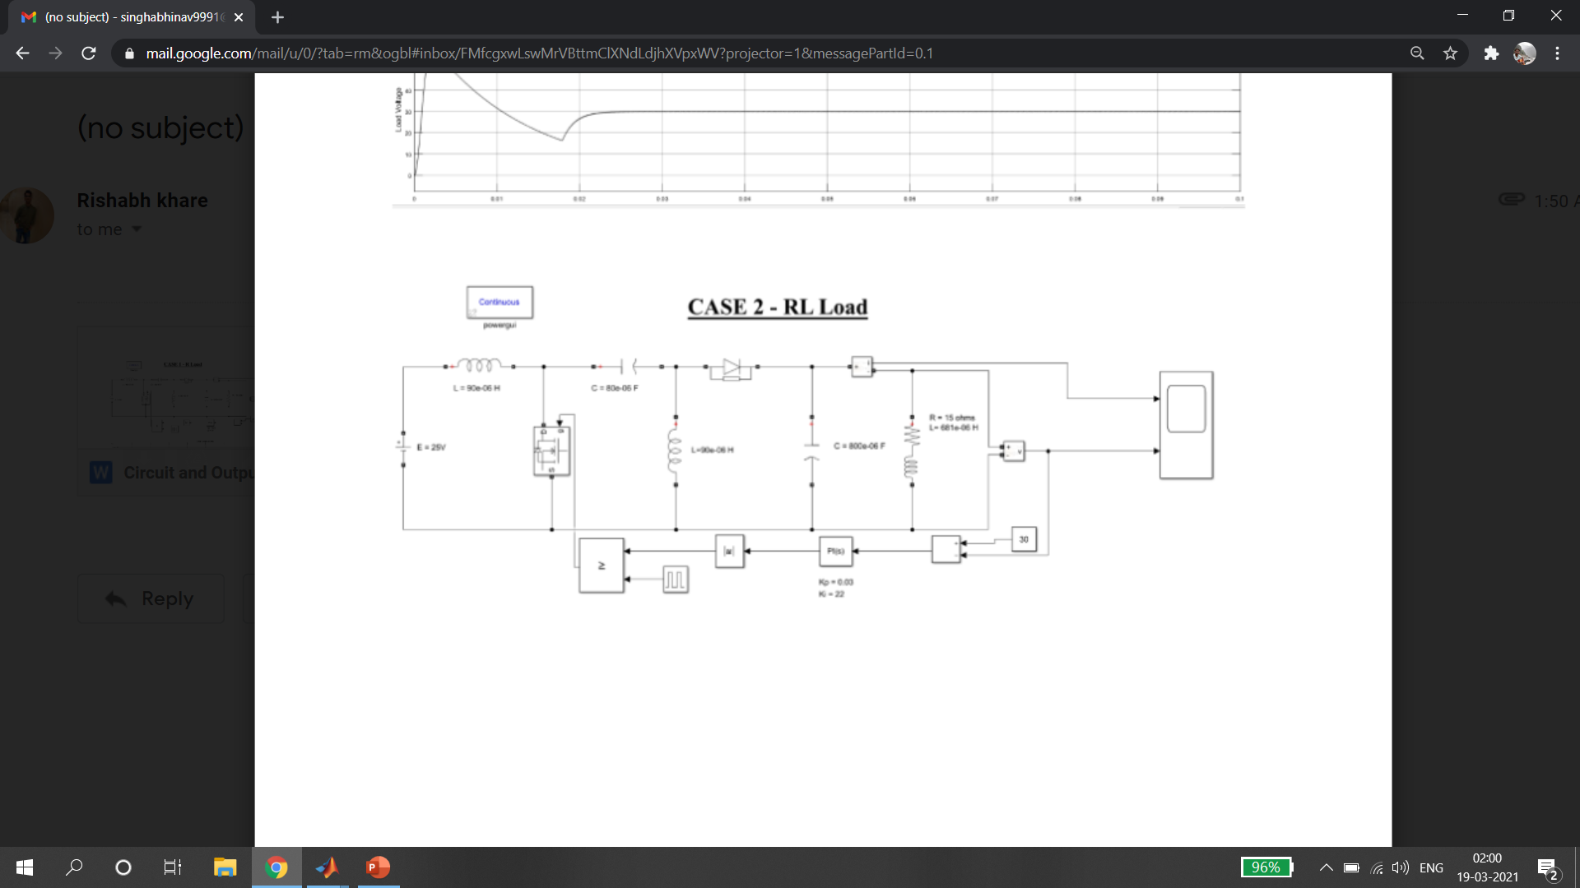
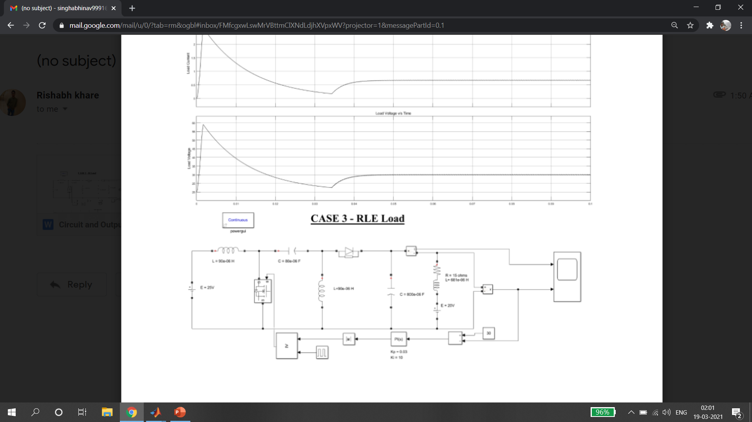

Slide 19
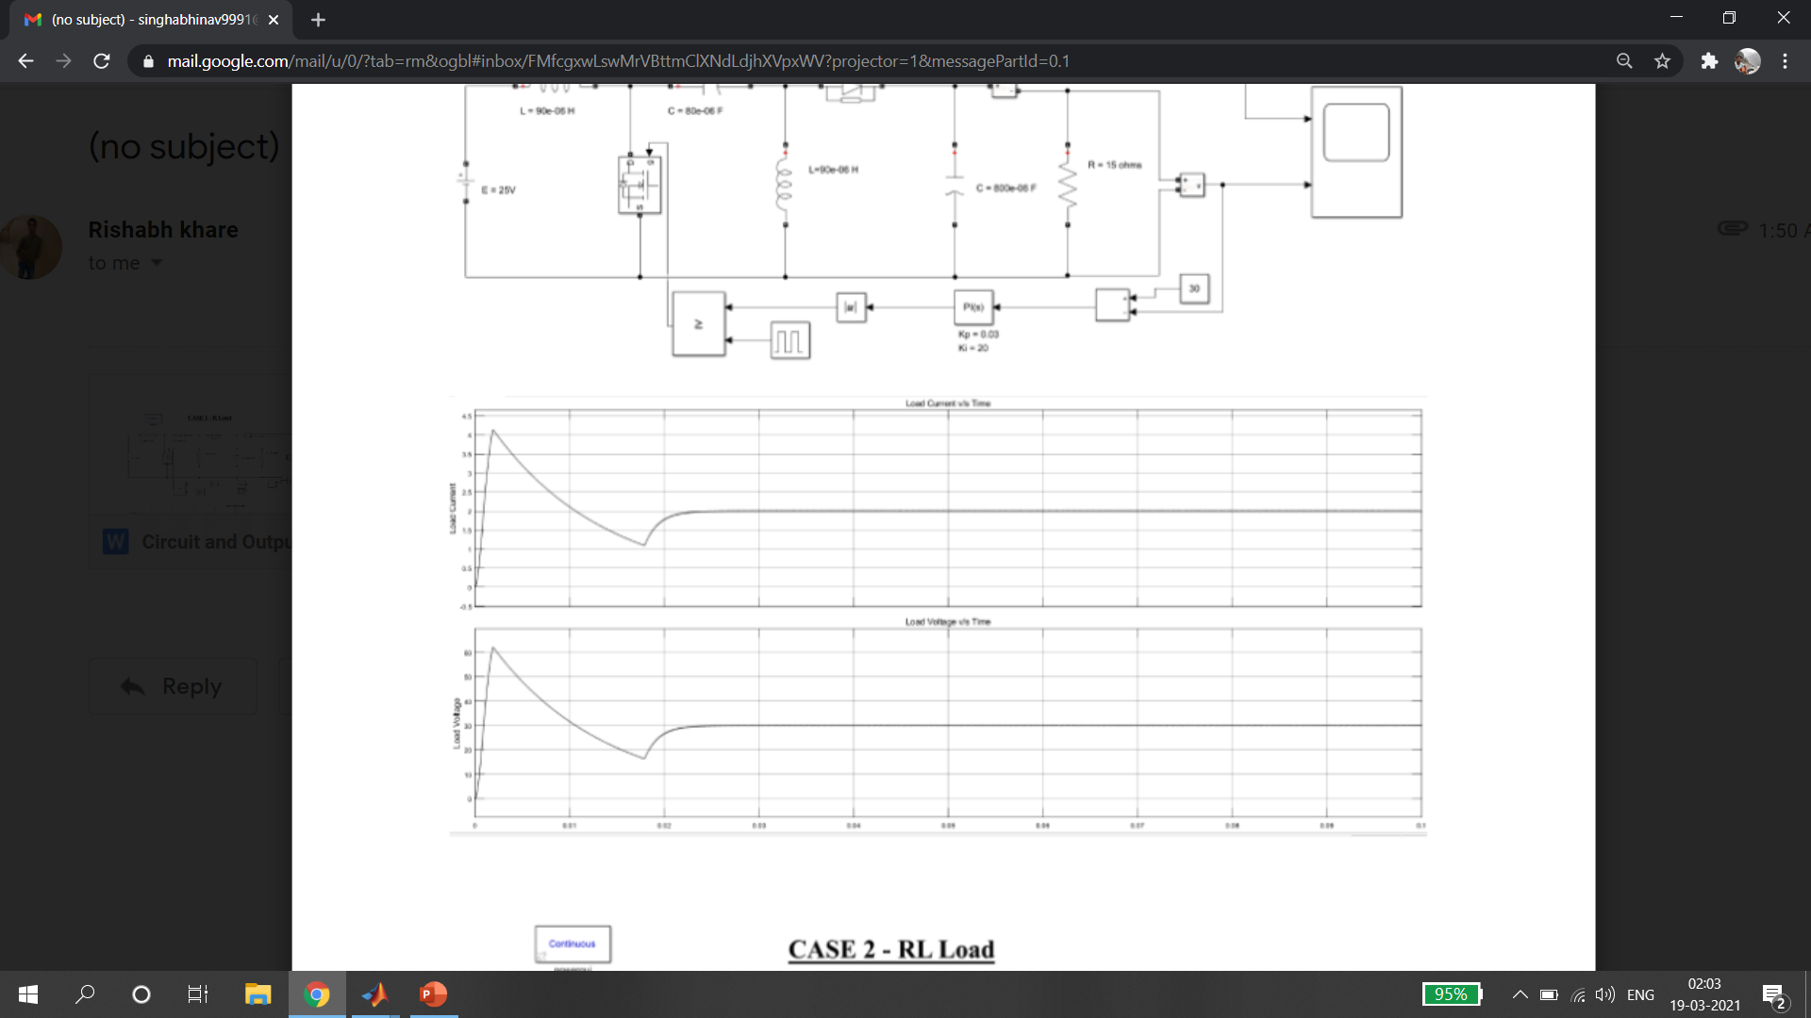
GRAPHICAL RESULTS
Case 1: For R Load

Slide 20
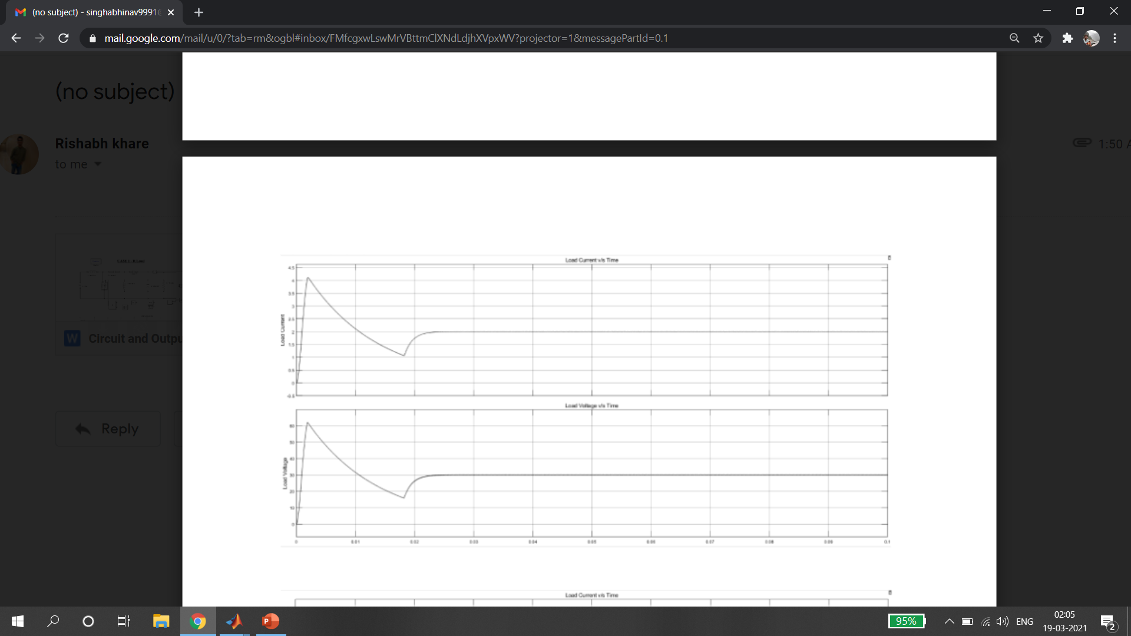
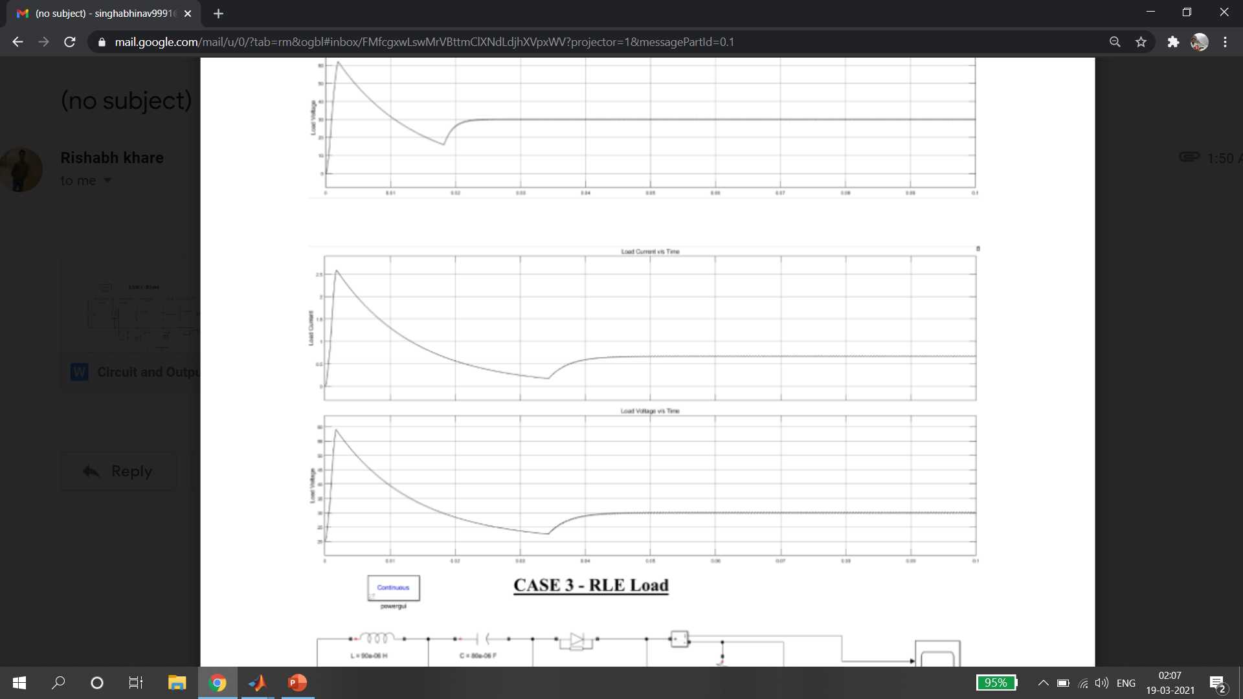
Case 2: For R-L Load
Case 3: For RLE Load

Slide 21
Battery

Slide 22
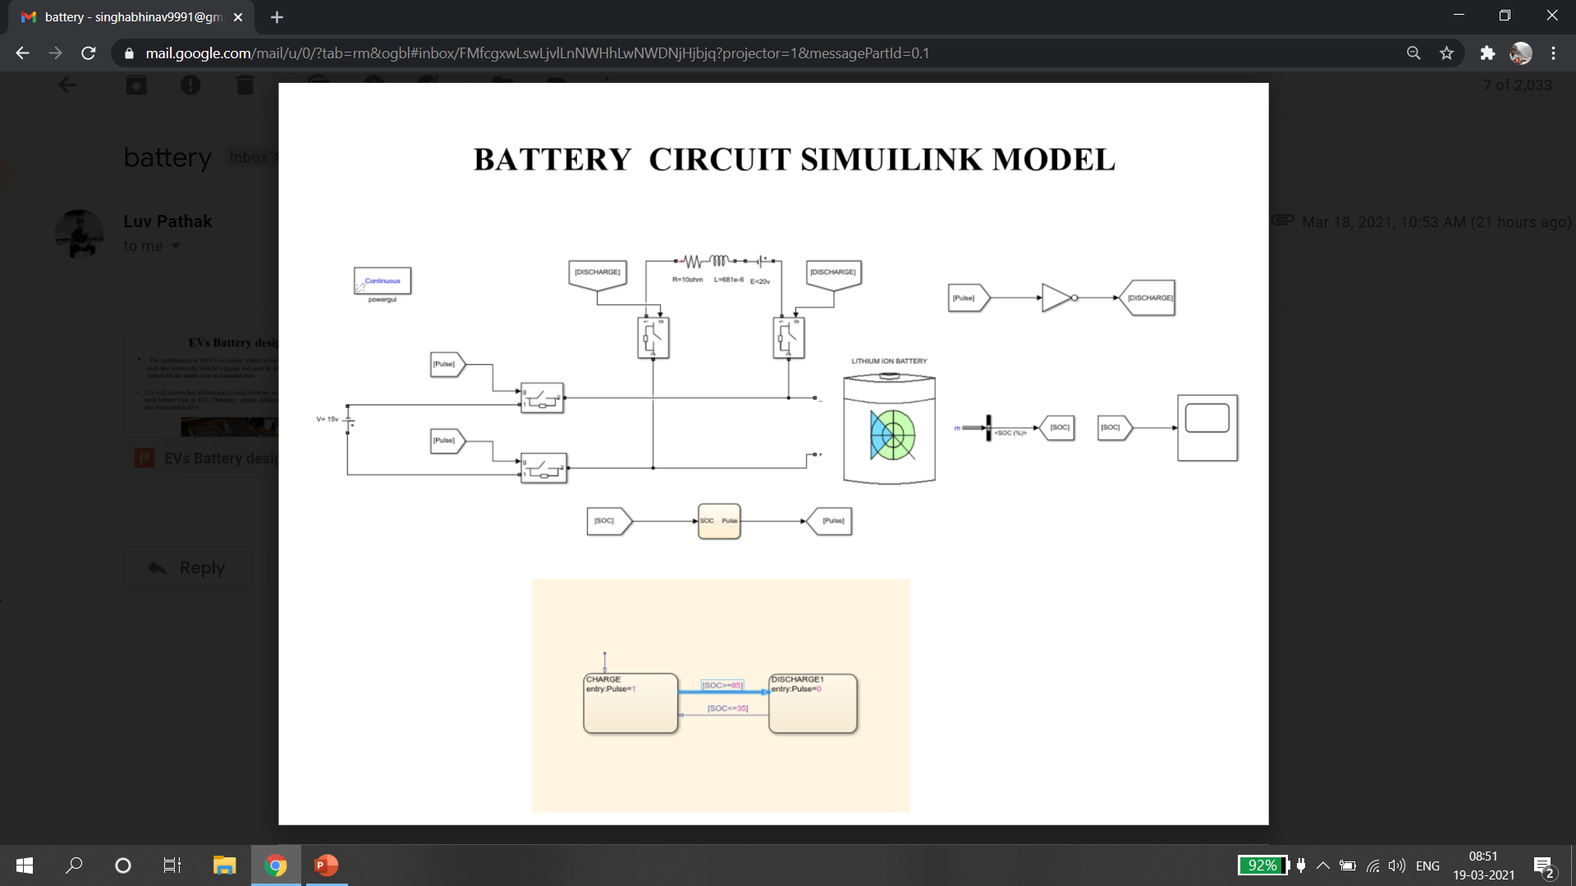
SIMULINK MODEL

Slide 23
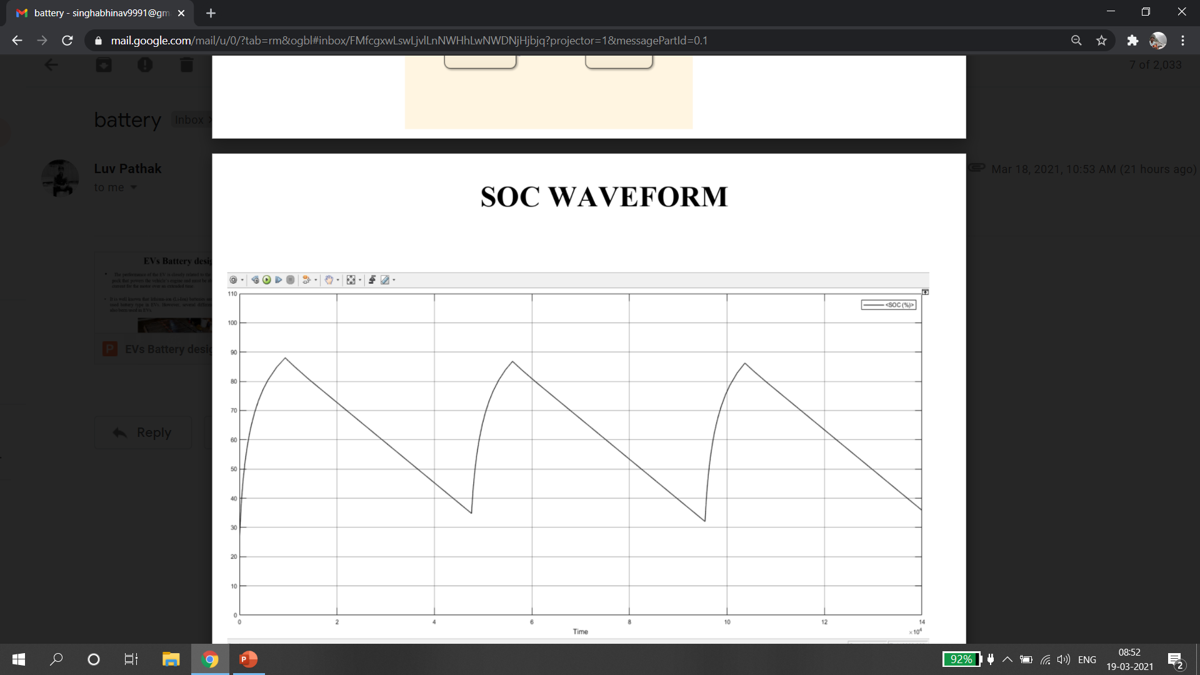
GRAPHICAL RESULTS

Slide 24
REFERENCES
[1] Amit Tripathi, Anurag Verma, “Design and Implementation of Cuk Converter for Power Factor Correction of PMBLDC Motor Drive”, International Journal of Recent Technology and Engineering (IJRTE) ISSN: 2277-3878, Volume-8, Issue-2S11, September 2019.
[2] Ryan Collin, Yu Miao, Alex Yokochi, Prasad Enjeti and Annette von Jouanne, “Advanced Electric Vehicle Fast-Charging Technologies”, Department of Electrical and Computer Engineering, Texas A&M University, College Station, TX 77843, USA, 15 May 2019.
[3] Sajib Chakraborty, Hai-Nam Vu, Mohammed Mahedi Hasan, Dai-Duong Tran, Mohamed El Baghdadi and Omar Hegazy, “DC-DC Converter Topologies for Electric Vehicles, Plug-in Hybrid Electric Vehicles and Fast Charging Stations: State of the Art and Future Trends”, ETEC Department & MOBI Research Group, Vrije Universiteit Brussel (VUB), Pleinlaan 2, 1050 Brussels, Belgium, 25 April 2019.
[4] Feyijimi Adegbohun, Annette von Jouanne and Kwang Y. Lee Autonomous Battery Swapping System and Methodologies of Electric Vehicles, Department of Electrical and Computer Engineering, Baylor University, Waco, TX 76798, USA,19 February 2019
[5] U.S. Energy Information Administration—EIA—”Independent Statistics and Analysis: Does the World Have Enough Oil to Meet Our Future Needs?”, 13 February 2019.
[6] Saharul Arof, N.Diyanah N.Ha , Philip Mawbyb , H. Arofc , Nurazlin Mohd Yaakopa, Electrical Electronic Automation Section, University Kuala Lumpur, Malaysian Spanish Institute, Kulim Hi-Tech Park, 09000 Kulim, Kedah, Malaysia 2019.
[7] Kishore Naik Mude, Battery Charging Method for Electric Vehicles: From Wired to On-Road Wireless Charging, Solace Power Inc., 1118 Topsail road Mount Pearl, Newfoundland and Labrador, A1N5E7, Canada,4 December 2018.
[8] 2018 Chevrolet Bolt EV Features & Specs ,31 October 2018.
[9] Pradeep Kumar Akhlaque Ahmad Khan Prabhat Ranjan Sarkar, “Single Switch AC-DC Cuk Converter for Power Factor and Efficiency Enhancement”, International Journal of Innovative Science and Research Technology, Volume 3, Issue 4, April – 2018

Slide 25
[10] Chevy EV Life: Bolt EV Charging Guide | Chevrolet , March 2018.
[11] S. Arof, N.M. Noor, F. Elias, P.A. Mawby, H. Arof, “Investigation of chopper operation of series Motor Four Quadrants DC Chopper”, Journal of Applied Environmental and Biological Science. J. Appl. Environ. Biol. Sci., 7(3S)49-56, 2017.
[12] S.Arof, H. Hassan, M. Rosyidi, P.A. Mawby, H. Arof, “Implementation of Series motor four quadrants Drive dc chopper for dc drive electric car and LRT”, Journal of Applied Environmental and Biological Science. J. Appl. Environ. Biol. Sci., 7(3S)73-82, 2017
[13] R. Kushwaha and B. Singh, "A Power Quality Improved EV Charger with Bridgeless Cuk Converter," 2018 IEEE International Conference on Power Electronics, Drives and Energy Systems (PEDES), Chennai, India, 2018, pp. 1-6, doi: 10.1109/PEDES.2018.8707701.[2] B. Zhao, A. Abramovitz and K. Smedley, “Family of bridgeless buck-boost PFC rectifiers,” IEEE Transactions Power Electronics, vol. 30, no. 12, pp. 6524-6527, Dec. 2015.
[14] Saharul Arof, Muhd Khairulzaman, A.K. Jalil, H. Arof, Mawby, P.A. (2015) “Self Tuning Fuzzy Logic Controlling Chopper Operation of Four Quadrants Drive DC Chopper for Low Cost Electric Vehicle”, 6th International Conference on Intelligent Systems, Modelling and Simulation, IEEE computer Society, p.p 40-24,. DOI: 10.1109/ISMS.2015.34
[15] Afida Ayob, Wan Mohd Faizal Wan Mahmood, Azah Mohamed, Mohd Zamri Che Wanik, “Review on Electric Vehicle, Battery Charger, Charging Station and Standards”, Department of Electrical, Electronic and Systems Engineering, University Kebangsaan, Malaysia 10 January 2014.
[16] K. T. Mok, Y. M. Lai, K. H. Loo, “A Single-Stage Bridgeless Power-Factor-Correction Rectifier Based on Flyback Topology,” in Proc. of 33rd Int. IEEE Telecom. Conf. (INTELEC), 9-13 Oct. 2011, pp. 1-6.
[17] A. Abramovitz, and K. M. Smedley, “Analysis and design of a tapped-inductor buck-boost PFC rectifier with low bus voltage,” IEEE Trans. Power Electronics, vol. 26, no. 9, pp. 2637–2649, Sep. 2011.
[18] Yimin Gao and Mehrdad Ehsani, (2010) “Design and Control Methodology of Plug-in Hybrid Electric Vehicles”, IEEE Trans. Ind. Electron, VOL. 57, NO. 2, pp 633-640.
[19] L. Huber, J. Yungtaek, M. M. Jovanovic, "Performance Evaluation of Bridgeless PFC Boost Rectifiers," Applied Power Electronics Conference, APEC 2007 - Twenty Second Annual IEEE , vol., no., pp.165-171, Feb. 25 2007-March 1 2007.

Slide 26
[20] Pradeep Kumar, Akhlaque Ahmad Khan, Prabhat Ranjan Sarkar, Electrical Engineering Department, Integral University, Lucknow, India, Single Switch AC-DC Cuk Converter for Power Factor and Efficiency Enhancement, 4 April 2018.
[21] Zeeshan Rayeen, Sourav Bose, Prakash Dwivedi, Department of Electrical Engineering, NIT Uttarakhand, India, Study of Closed loop Cuk converter controlled by Loop Shaping Method, 2018.
[22] Sofyan M. Ilman, Andriazis Dahono, Muhammad Aji K. Prihambodo, School of Electrical Engineering and Informatic Bandung Institute of Technology Bandung, Indonesia, 2019.
[23] P.Nagalakshmi Kanna, Dr.B.Meenakshi, Department Of EEE, Sri Sai Ram Engineering College, Chennai, Tamil Nadu, India, Analysis and Design of DC- DC/AC Non Isolated Cuk Converter using Sliding Mode Controller, 2015.
[24] Wenzheng Xu, K.W.E Cheng, K.W.E Chan, Department of Electrical Engineering, The Hong Kong Polytechnic University, Hong Kong, Application of Cuk converter together with Battery Technologies on the Low Voltage DC supply for Electric Vehicles, 2018.
[25] S. Sivajanani,N. Veeramuthulingam, N. Arunkumar, D. Balaji, Department of Electrical and Electronics Engineering, Manakula Vinayagar Institute of Technology Puducherry, India, Analysis of Cuk Converters for Power Factor Correction Applications, 5 May 2014.
[26] J. Hoyo, J. Alcala and H. Calleja, Department of Electronics, Interior Intemado Palmira s/n. Cuernavaca, Mor., Mexico,A High Quality Output AC/AC Cuk Converter, 2004.
[27] N.A.A. Isa, W.M. Utomo, M. K. R. Noor, M.A.Z.A. Rashid, A.F.H.A. Gani, A.A. Bakar, S.S. Yi, Iradiatu Diah P K, Performance Between PFC Cuk and Bridgeless PFC Cuk Converter with Various Output Voltages, July 2019.
[28] L. Huber, Y. Jang, and M. Jovanovic, “Performance evaluation of bridgeless PFC boost rectifiers,” IEEE Transactions Power Electronics, vol. 23, no. 3, pp. 1381–1390, May 2008.

Slide 27
[29] B. Zhao, A. Abramovitz and K. Smedley, “Family of bridgeless buck-boost PFC rectifiers,” IEEE Transactions Power Electronics, vol. 30, no. 12, pp. 6524-6527, Dec. 2015.
[30] A. A. Fardoun, E. H. Ismail, A. J. Sabzali and M. A. Al-Saffar, “New Efficient Bridgeless Cuk Rectifiers for PFC Applications,” IEEE Transactions on Power Electronics, vol. 27, no. 7, pp. 32923301, July 2012.
[31] H. Nene, C. Jiang, and S. Choudhury, “Control for Light Load Efficiency and THD Improvements in PFC Converter,” pp. 1785–1788, 2017.
[32] H. T. Yang, H. W. Chiang, and C. Y. Chen, “Implementation of Bridgeless Cuk Power Factor Corrector With Positive Output Voltage,” IEEE Trans. Ind. Appl., vol. 51, no. 4, pp. 3325–3333, 2015.
[33] . Sabzali, E. H. Ismail, M. A. Al-Saffar, and A. A. Fardoun, “A new bridgeless PFC Sepic and Cuk rectifiers with low conduction and switching losses,” 2009 Int. Conf. Power Electron. Drive Syst., pp. 550–556, 2009
[34] Y. Jang and M. M. Jovanovi´ c, “Bridgeless high-power-factor buck converter,” IEEE Trans. Power Electron., vol. 26, no. 2, pp. 602– 611, Feb.2011
[35] B. Zhao, A. Abramovitz and K. Smedley, “Family of bridgeless buck-boost PFC rectifiers,” IEEE Transactions Power Electronics,vol. 30, no. 12, pp. 6524-6527, Dec. 2015.
[36] Somayajula, D., & Ferdowsi, M. (2009), “Power Sharing in a Double-Input Buck-boost Converter Using Offset Time Control” 2009.

Slide 28
[37] Somayajula, D., & Ferdowsi, M. (2010), “Small-signal modelling and analysis of the double-input buck-boost converter” 2010
[38] Veerachary, M. (2018), ”Design and Analysis of Fifth-order Buck-Boost Converter”, 2018 2nd IEEE International Conference on Power Electronics, Intelligent Control and Energy Systems”
[39] Jaschke, R. (2007), ”Conduction Losses in DC/DC-Converters as buck-boost/boost-buck synchronous rectifier types” 2007 Compatibility in Power Electronics.
[40] R. M. Schupbach, J. C. Balda, M. Zolot, and B. Kramer, “Design methodology of a combined battery-ultracapacitor energy storage unit for vehicle power management,” in Proc. IEEE Power Electronics Conf., 15-19 Jun. 2003, vol. 1, pp. 88-93.
[41] Tsai-Fu Wu; Yu-Kai Chen. “A systematic and unified approach to modelling PWM DC/DC converters based on the graft scheme”, IEEE Transactions on Industrial Electronics, vol. 45, no.1, pp. 88-98, Feb. 1998.
[42] A. A. Fardoun, E. H. Ismail, “Bridgeless SEPIC rectifier with unity power factor and reduced conduction losses,” IEEE Trans. Ind. lectron., vol. 56, no.4, pp. 1147–1157, April 2009.
[43] Y. M. Chen, Y. C. Liu, and F. Y. Wu, “Multi-input converter with power factor correction, maximum power point tracking, and ripple-free input currents”, IEEE Trans. Power Electronics, vol. 19, pp. 631-639, May 2004.
[44] W. Sutopo, M. Nizam, B. Rahmawatie and F. Fahma, "A Review of Electric Vehicles Charging Standard Development: Study Case in Indonesia," 2018 5th International Conference on Electric Vehicular Technology (ICEVT), Surakarta, Indonesia, 2018, pp. 152-157, doi: 10.1109/ICEVT.2018.8628367.
[45] Pandav Kiran Maroti, Sanjeevi Kumar Padmanaban, Jens Bo Holm-nielsen, Mahajan Sagar Bhaskar, Mohammad Meraj, Atif Iqbal, “A New Structure of High Voltage Gain SEPIC Converter for Renewable Energy Applications”, IEEE ACCESS, July 23, 2019. (Journal)

Slide 29
[46] Ibrahim A. AlMohaisin , Ahmed A. Mahfouz , V. T. Akhila, “A Review on SEPIC Converter Topologies”, International Journal of Research in Engineering, Science and Management Volume-2, Issue-12, December-2019.(Journal)
[47] H. Suryoatmojo, I. Dilianto, Suwito, R. Mardiyanto, E. Setijadi and D.C. Riawan, “Design and Analysis of High Gain Modified SEPIC Converter for Photovoltaic Applications”, 2018 IEEE International Conference on Innovative Research and Development (ICIRD) 11-12 May 2018.(Research Paper)
[48] Jingying Hu, Anthony D. Sagneri, Juan M. Rivas, Yehui Han, Seth M. Davis, David J. Perreault, “High Frequency Resonant SEPIC Converter with Wide Input and Output Voltage Ranges”, IEEE TRANSACTIONS ON POWER ELECTRONICS, Vol. 27, No. 1, pp. 189-200, Jan. 2012.(Research Paper)
[49] Trivedi Bhavin, Bhavesh Patel, Jay Desai, Kamlesh Sonwane, ” Analysis of SEPIC Converter”, IJEDR 2018.(Journal)
[50] Gajalakshmi M, Dr Karpagavalli P, ”Design and Analysis of a SEPIC Integrated Boost (SIB) Converter using Coupled Inductor”, International Research Journal of Engineering and Technology (IRJET), Volume: 07 Issue: 03, March, 2020.(Journal)
[51] O. Kircioğlu, M. Ünlü and S. Çamur, "Modeling and analysis of DC-DC SEPIC converter with coupled inductors," 2016 International Symposium on Industrial Electronics (INDEL), Banja Luka, 2016.(Research Paper)
[52] Fakirrao T.Chavan, Shrikant S.Mopari , Panchayya S. Swami, “Performance Analysis Of SEPIC And Zeta Converter For Power Quality Improvement”, INTERNATIONAL JOURNAL OF SCIENTIFIC & TECHNOLOGY RESEARCH VOLUME 8, ISSUE 12, DECEMBER 2019.(Journal)
[53] Subramani Saravanan, Neelakandan Ramesh Babu, “A modified high step-up non-isolated DC-DC converter for PV application”, Journal of Applied Research and Technology, May 15, 2016.(Journal)

Slide 30
[54] Yelamarthi Bhaskar S.S. Gupta, Sri Rama Lakshmi P, “Analysis and Design of CUK Converter using PI Controller for PV Application”, January 2014, International Journal of Scientific & Technology Research.
[55] Karuppiah, M., Karthikumar K., & Arunbalj, A. (2017), ”A transformerless buck-boost converter with PID controller (closed loop controller)”, 2017 IEEE International Conference on Intelligent Techniques in Control, Optimization and Signal Processing (INCOS).
[56] M.Karuppiah, K.Karthi Kumar and A.Arunbalaj “The Residential Dc Power Distribution with Multi-Input Single-Control Systems,” International Journal Of Engineering Trends And Technology (IJETT) Volume 17, Issue 4, Nov-2014.
[57] A. Ajami, H. Ardi, and A. Farakhor, “Design, analysis and implementation of a buck–boost DC/DC converter,” IET Power Electron., vol. 7, no. 12, pp. 2902–2913, Dec. 2014.
[58] M. Karuppiah, K. Karthikumar, A. Arunbalaj, L. Dineshbabu and S. Krishnakumar, “Improved DC Power Distribution with Multi input Single Control System using Boost Converter”, International Journal Of Applied Engineering Research (IJAER),” Volume No.10, Issue No.3, Jan 2015.

Slide 31
THANK YOU

